Slide 1
askGod Hack2021
Question & Scripture Representations with Matching
By Rachel Ding & Larry Walters

Slide 2
The Challenge
People have questions, but don’t know God has answers for them, or they don’t know how to find those answers in the Bible
How to represent a user’s question, what are they really asking?
How to represent a Scripture passage, what is it really talking about?
Matching those two

Slide 3
What We Did
Enlisted the help of Jason and his pet Python
Defined two data structure objects, one to for questions, one for verses
Filtering algorithm - sequence of “filters” which each compare certain parts of the two data structures to each other, scoring the verses that most closely match.
The sum of scores from all filters is added in the end.
Verses with the highest score are the answer to their question
Parsing questions and passages into these formats is daunting and difficult - hard code the data
Assume those pieces are handled, and just focus on the structure and the matching

Slide 4
The Data (Question Context)
{
"question-text": "Does the Bible say it is a sin to cry?",
"significant-words": [ "Bible", "sin", "cry" ],
"relates-to": [],
"scripture-section" : "Both",
"emotions": [ "confusion" ],
"preconceptions": [ "legalistic", "not meaningful" ],
"people": [],
"places": [],
"actions": [ "say", "cry" ],
"believer" : false,
"question-type" : {
"type": "clarification",
"subject": "crying",
"action": [ "sinful", "wrong" ]
},
"verse-in-the-question" : "" }

Slide 5
The Data (Passage Context)
{
"passage": "Rev.21.4-Rev.21.5",
"scripture-section": "NT",
"applies-to": {
"general": ["believer", "unbeliever"],
"family-relation": [],
"occupation": []
},
"questions": [ "Does the Bible say it is a sin to cry?", … ]
"question-types": [
{
"type": "clarification",
"subject": "crying",
"action": ["sinful", "wrong"]
}
],
"people": ["God"],
"places": ["throne", "heaven"],
"actions": ["wipe every tear", "crying", … ],
"lesson": {
"situation": "sadness",
"godly-response": [
"God cares",
"There won't be grief in heaven",
"God makes everything new"
],
"worldly-response": [
"hide it inside",
"isolate yourself",
"self-medicate with pleasures"
],
"believer": "both"
}
}

Slide 6
Some Examples of Filters
People / Places / Actions
“people” : [ “Moses”, “Jesus” ] < ----- > “people” : [ “Jesus” ]
Scripture Section
If question seems to be about OT, and the passage is in the NT, decrease the score, and vice versa
Question Similarity (combo filter)
Search for significant words in associated questions:
“significant-words” : [ “rise”, “dead”, “third day” ] ------> “questions” : [ “Did Jesus rise from the dead?” ]
Do similarity search on associated questions with new question as input query (didn’t get to implement yet)
And More...

Slide 7
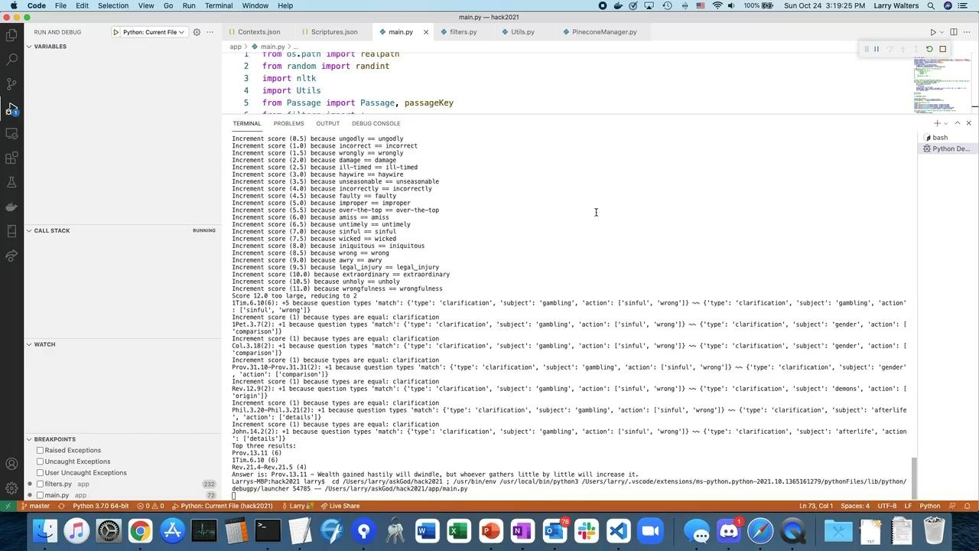
Demo

Slide 8
Benefits
Much richer way to understand what a passage is talking about. Previous model was based on topics to verses
Better understanding of a question, not simply keyword based or a vector of words passed into a model
Filters are extensible and scalable, also have sub-filters - can be easily expanded

Slide 9
Results & Next Steps
Didn’t have time to implement all the filters and do adequate testing
Continue to build and improve filters / algorithm
Figure out how to parse questions and passages into these formats
Combination of hard-coding and automation
Integrate with existing website

